Slide 1
COS 432: Information Security
Nick Feamster

Slide 2
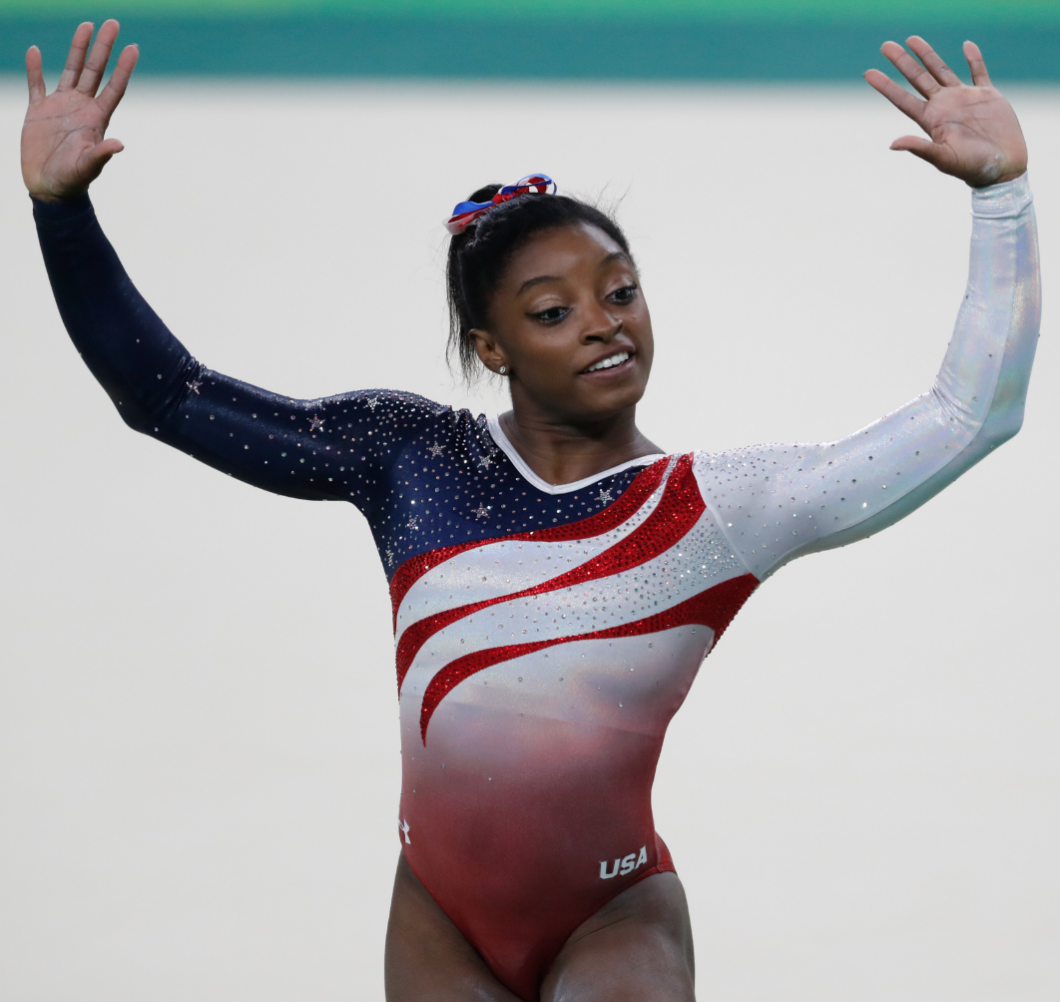

Slide 3



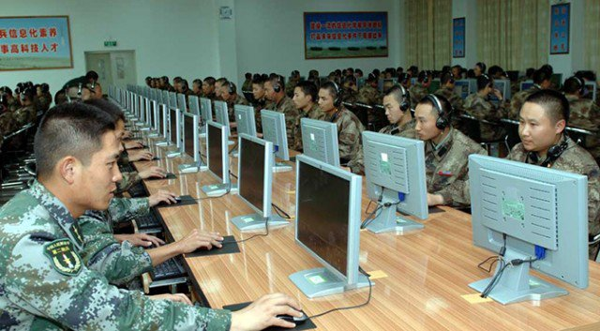
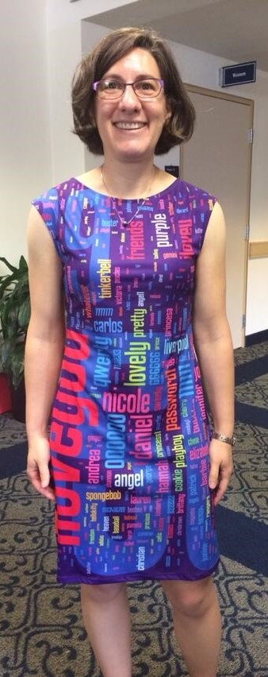
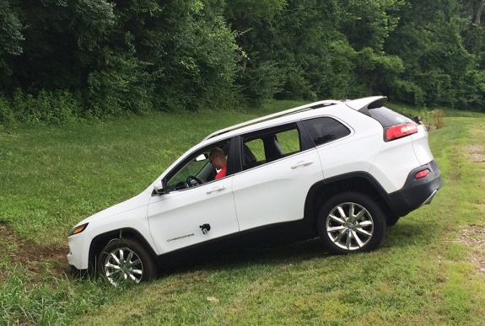
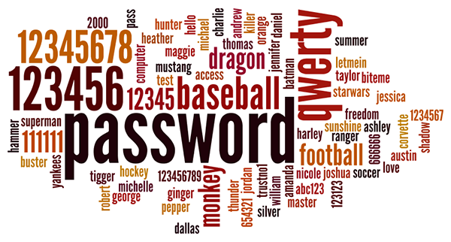
Notes:
OPM hack, iCloud leak, heartbleed bug, Jeep remote vulnerability, weak passwords

Slide 4
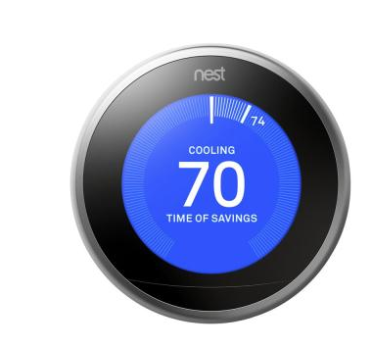
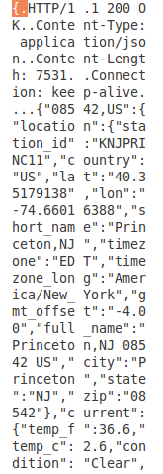
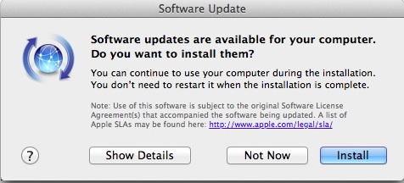

Slide 5
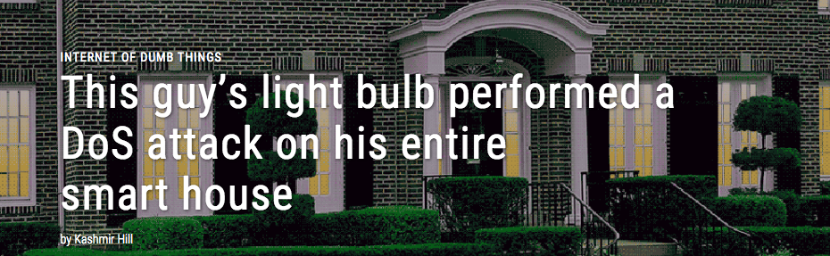

Slide 6
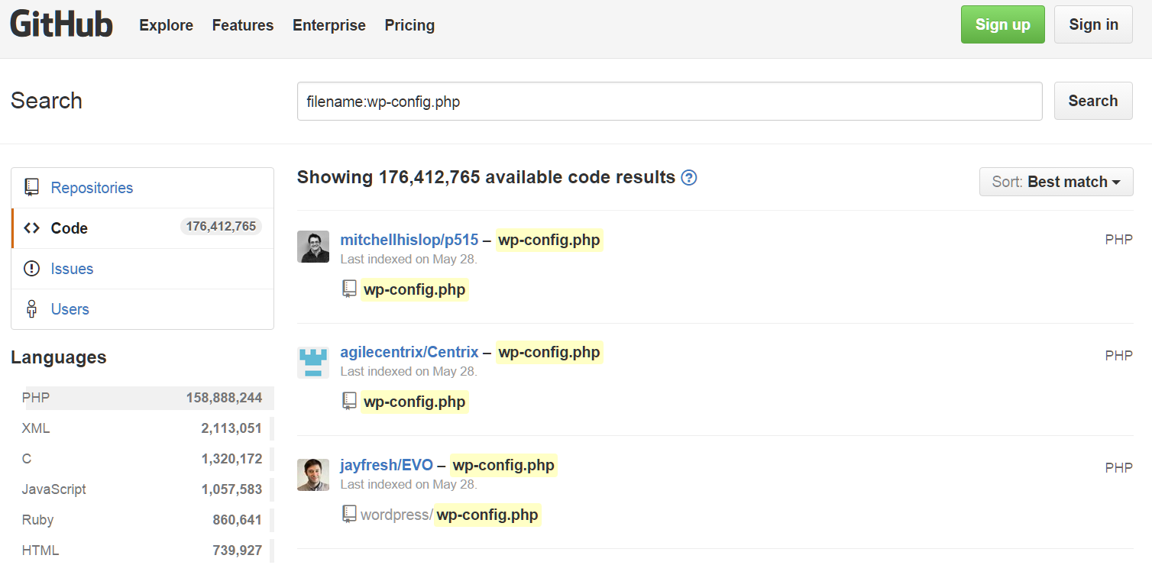
Notes:
Config files with passwords publicly uploaded to GitHub

Slide 7








Slide 8
Goals for this Course
Critical thinking
How to think like an attacker
How to reason about threats and risks
How to balance security costs and benefits
Technical skills
How to protect yourself
How to manage and defend systems
How to design and program secure systems
Learn to be a security-conscious citizen
Learn to be a 1337 hax0r, but an ethical one!

Slide 9
What You’ll Learn
Design a secure system
Probe systems for weaknesses
Write code with fewer security bugs
Use crypto libraries correctly
NOT how to roll your own crypto code
Reason about / protect / breach privacy
Use your powers ethically

Slide 10
What is Computer Security?
Math?
Engineering?
Philosophy?
Natural Sciences?

Slide 11

Meet the Adversary
“Computer security studies how systems behave in the presence of an adversary.”
The adversary
a.k.a. the attacker
a.k.a. the bad guy
An intelligence that actively tries to cause the system to misbehave.

Slide 12
“Know your enemy.”
Motives?
Capabilities?
Degrees of access?

Slide 13
The Security Mindset
Thinking like an attacker
Understand techniques for circumventing security.
Look for ways security can break, not reasons why it won’t.
Thinking like a defender
Know what you’re defending, and against whom.
Weigh benefits vs. costs: No system is ever completely secure.
“Rational paranoia!”

Slide 14
High-Level Approaches
Attacks
Defenses

Slide 15
Why Study Attacks?
Identify vulnerabilities so they can be fixed.
Create incentives for vendors to be careful.
Learn about new classes of threats.
Determine what we need to defend against.
Help designers build stronger systems.
Help users more accurately evaluate risk.

Slide 17
Thinking as a Defender
Security policy
What are we trying to protect?
What properties are we trying to enforce?
Threat model
Who are the attackers? Capabilities? Motivations?
What kind of attack are we trying to prevent?
Risk assessment
What are the weaknesses of the system?
What will successful attacks cost us?
How likely?
Countermeasures
Costs vs. benefits?
Technical vs. nontechnical?
Challenge is to think rationally and rigorously about risk. Rational paranoia.

Slide 18
Threat
A set of circumstances that has the potential to cause loss or harm
Vulnerabilities can occur without threats: access to buggy software is blocked by a firewall
Threats can occur without vulnerabilities: fire can destroy a data center

Slide 19
Attacks
Eavesdropping
Interruption/Disruption
Alteration
Fabrication
Notes:
– Eavesdropping
– Monitor email, spyware
– MITM attack against web commerce, SSL supposed to prevent
– Interruption
– Denial of service, block traffic, consume resources – Alteration
– SQL injection attack that drops main customer table – Fabrication
– Spoof email address
– Replay previously observed credential

Slide 20
Threat Models
Who are our adversaries?
Motives?
Capabilities?
What kinds of attacks do we need to prevent? (Think like the attacker!)
Limits: Kinds of attacks we should ignore?

Slide 21
Assessing Risk
Remember: Controlled paranoia
What would security breaches cost us?
Direct costs: Money, property, safety, ...
Indirect costs: Reputation, future business, well being, …
How likely are these costs?
Probability of attacks?
Probability of success?

Slide 22
Countermeasures
Technical countermeasures
Nontechnical countermeasures
Law, policy (government, institutional), procedures, training, auditing, incentives, etc.

Slide 23
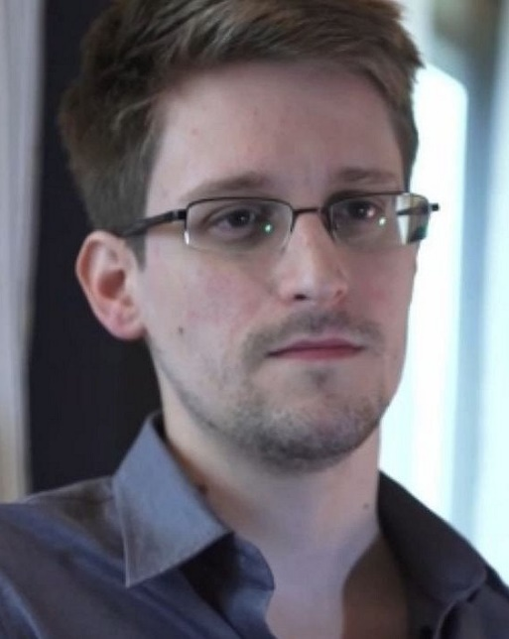
Encryption works. Properly implemented strong cryptosystems are one of the few things that you can rely on.
Notes:
Technology can help shift the traditional balance of power
No longer true that gov’t can break any encryption by throwing enough smart people and computers at it. Of course, adversaries can exploit bugs in the software that implements the encryption

Slide 24
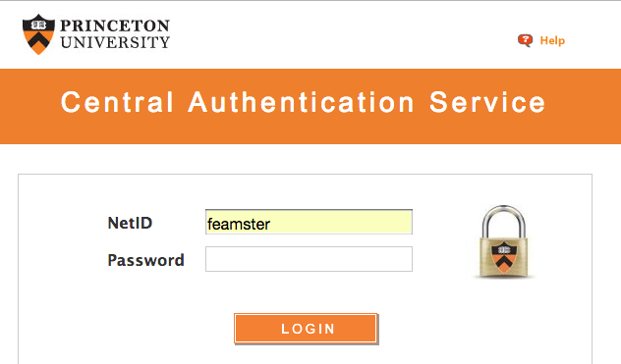
Defense in Depth
Encryption
Software Controls
Hardware Controls
Physical Access Control
Notes:
Encryption
– [draw picture]
– plaintext + key --> [encipher] --> ciphertext
– ciphertext + key --> [decipher] --> plaintext
– Basis of numerous security protocols
– Provides data confidentiality & integrity (how?)
– Does it provide availability?
– Software controls
– Access controls in DBMS & OS
– Program design & QA
– Attack detection: virus scanners, IDS
– Vulnerability patching
– Hardware controls
– Smart cards / multi-factor authentication
– Cable locks [example: after breaking in, attackers walk out with
entire VCR recording surveillance cameras]
– Attack prevention: firewalls, IPS
– Physical access control
– Guards
– Principle of weakest link: Security can be no stronger than its weakest link

Slide 25
Security Costs
No security mechanism is free
Direct costs: Design, implementation, enforcement, false positives
Indirect costs: Lost productivity, added complexity
Challenge is rationally weigh costs vs. risk
Human psychology makes reasoning about high cost/low probability events hard

Slide 26
Thought Exercise
Should you lock your door?
Assets?
Adversaries?
Risk assessment?
Countermeasures?
Costs/benefits?

Slide 27
Thought Exercise
Should you lock your bike?

Slide 28
To Learn More …
The Security Mindset. https://www.schneier.com/blog/archives/2008/03/the_security_mi_1.html
https://freedom-to-tinker.com/blog/felten/security-mindset-and-harmless-failures/
https://cubist.cs.washington.edu/Security/2007/11/22/why-a-computer-security-course-blog/

Slide 29
Points of Vulnerability
A weakness in the security system that might be exploited to cause harm.
Hardware
Software
Data
Networks
People
Notes:
Points of vulnerability – Hardware
– Accidental misuse (soda, corn chips, fire) – (story of water into laptop keyboard at conference)
– Deliberate misuse (fire extinguisher into system, theft)
– What kind of attacks are these?
– Note that theft may lead to data loss, so confidentiality attack
– Software
– Bugs in network server programs
– Modification (remove license checks)
– Backdoors, trojans, worms, viruses, spyware, rootkits
– Intentional errors inserted by malicious programmers (Linux kernel
code example)
– Data
– Confidentiality & integrity primary concerns
– In 2007, the UK government lost 37 million items of personal data
– Networks
– Allows outside world to access your systems
– Wireless networks for laptops often allow insiders to bypass firewalls
– People
– Social engg
– The best technical security solutions fail when users are naïve
Def: Vulnerability
– A weakness in the security system that might be exploited to cause harm
– Ex: in procedures, policy, design, or implementation
– OpenBSD philosophy: software bugs are vulnerabilities that attackers
aren't yet smart enough to break

Slide 30
Course Logistics

Slide 31
Course Structure
Cryptography
Application Security
Web Security
Network Security
“Security In Context”

Slide 32
Instructors
Assistants: Sotiris Apostolakis, Qipeng Liu, Ming-Yee Tsang, William Yang
Office hours everyday
Office hours will increase near deadlines
Talk to the TAs about assignments!
Notes:
Nick: Mondays 1:30-2:30p (Sherrerd 310) [Wednesdays near deadlines] Sotiris: Tuesdays 2:00-4:00p (Outside CS 241) [Thursdays near deadlines]
Qipeng: Thursdays 1:30-3:30p
Ming-Yee: Fridays 2:00-4:00p
William: Wednesday 3:00-5:00p (Outside CS 241) [Mondays near deadlines]

Slide 33
Online Interaction and Participation
Piazza
Extended discussions
If you have an assignment question, check here first
Slack (https://cos432.slack.com/)
Quick questions, clarifications, collaborations and discussions with students
Blackboard
Lecture notes and readings

Slide 34
Lecture Notes and Readings
Slides will be on Blackboard
After class, not public
May be modified during lecture (will experiment)
No required textbook
Several optional books, see website
When appropriate, a paper or article for reading
Discussion will count towards participation grade

Slide 35
Collaboration Policies: Assignments
Find a partner for the assignments
You will keep this partner for all assignments
Changes are allowed, but as exceptions
Except where noted, you can collaborate with other pairs
You must acknowledge any collaborators
We reserve the right to run Moss, etc.

Slide 36
Collaboration Policy: Exams
One page of notes allowed
For one problem on the exam for which you are least sure of, you can write down the name of another student who you think is most likely to know the answer [Credit: Last Sunday’s New York Times]

Slide 37
Late Policy
You start the term with a grace period "balance" of 96 hours.
Each assignment will be due at 6:00 p.m. (Princeton Local Time) on the due date.
For each assignment, every hour late (or fraction thereof) that you turn in the assignment will subtract one hour from your grace-period balance. For example, if you turn in your assignment at 7:02 p.m. on the date of the due date, we will count this as two hours against your grace period.
As long as your grace period balance is positive, you can turn in any assignment late without penalty.
Once your grace period balance reaches zero, you will receive half credit for any assignment that you turn in, as long as you turn it in within one week of the due date. If your grace period balance is zero and you turn in an assignment more than one week late, you will receive no credit for the assignment. Important: You must still turn in all assignments to pass the course, even if you receive zero points on an assignment. Turning in all assignments is a necessary condition for passing.

Slide 38
Classroom Policies
Don’t use laptops in class.
Why?
Note-taking is OK, but Facebook is distracting to you and to other students.
Have a good reason? Talk to me first.

Slide 39
Grading
60% Assignments
Total of 5, evenly spaced
Java, Python
40% Exams
… Class participation
(Piazza, Lectures, Office Hours)

Slide 40

Security-oriented programming contest
Starts September 23
2-4 person teams
Extra credit
If you participate*, drop one assignment
If you place or win, drop one exam and one assignment
https://builditbreakit.org/

Slide 41
Class Participation
Contribute to the overall educational goals of the class
Some Ideas:
Participate in class discussion
Write up lecture notes
Answer questions on Piazza
Write up answers to questions posed in class
You’re welcome to think of other ideas

Slide 42
Setting Expectations

Slide 43
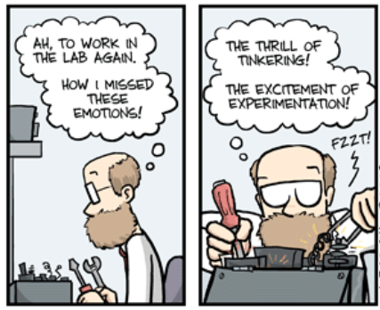

Slide 44
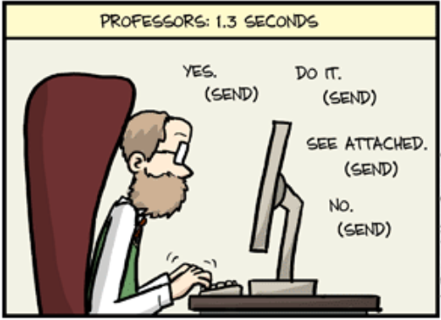

Slide 45
You are in a 400-Level Course
You are more mature (or at least more experienced!)
The staff is here to help, but upper-level courses evolve more rapidly (they have to)
Corollary: There may be bugs. We will fix them
Not everything may be completely specified. This is true in real life, too.

Slide 46
Contract: What I Expect From You
Effort, enthusiasm, thoughtful participation
Desire to learn (not just “get the grade”)
Prepare for class (do the readings if there are any; I will try to provide some)
Do your best to learn the material
Read, ask peers, use Piazza, think before asking
Apply what you learn, not just regurgitate it

Slide 47
Contract: What You Can Expect from Us
Availability during office hours
“Timely” responses (me for concepts, material, exams, etc.; staff for assignments)
Note: Last-minute requests cannot always be accommodated. Start early.
Prepared lectures that start and end on time
Notes from each lecture
Exams that challenge you to apply what you learn
Fair grading and timely feedback

